Slide 1
Lecture-25

Slide 2
MULTI DIMENSIONAL ARRAYS
A multi dimensional array is an array of arrays.
Like we have one index in a single dimensional array, two indices in a two dimensional array, in the same way we have n indices in a n-dimensional array or multi dimensional array.
Conversely, an n dimensional array is specified using n indices.
An n dimensional m1 x m2 x m3 x ….. mn array is a collection m1*m2*m3* ….. *mn elements.
In a multi dimensional array, a particular element is specified by using n subscripts as A[I1][I2][I3]…[In], where,
I1<=M1 I2<=M2 I3 <= M3 ……… In <= Mn

Slide 3
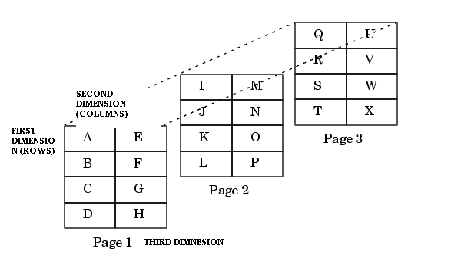

Slide 4
PROGRAM TO READ AND DISPLAY A 2X2X2 ARRAY
#include<stdio.h>
int main()
{ int array1[2][2][2], i, j, k;
printf(“\n Enter the elements of the matrix”);
for(i=0;i<2;i++)
{ for(j=0;j<2;j++)
{
for(k=0;k<2;k++)
{
printf(“\n array[%d][ %d][ %d] = ”, i, j, k);
scanf(“%d”, &array1[i][j][k]);
}
}
}
printf(“\n The matrix is : “);
for(i=0;i<2;i++)
{ printf(“\n\n”);
for(j=0;j<2;j++)
{
printf(“\n”);
for(k=0;k<2;k++)
printf(“\t array[%d][ %d][ %d] = %d”, i, j, k, array1[i][j][k]);
}
}
}

